Slide 1
Welcome to Anywhere

Slide 2

Anywhere is the parent company of some of the world’s leading real estate brokerage brands and service businesses.
Formerly known as Realogy, our company’s transformation is guided by a deep commitment to reimagine the consumer experience at any point in their home buying and selling journey — helping to empower everyone’s next move.

Slide 3



BUSINESS UNITS
Business Units
One of the nation’s
largest owner and
operator of residential
real estate brokerages.
Global franchisor of
some of the most recognized brands in
the real estate industry.
Leading full-service title and
settlement services company
serving real estate companies, corporations, and financial institutions.

Slide 4

BUSINESS UNITS
Anywhere
Full-Service Model

Slide 5
Anywhere by the Numbers

Slide 6
ANYWHERE BY THE NUMBERS
$6.9 Billion
RE VENUE GENER ATED IN 2022
1.2 Million
TR ANSACTION SIDES IN THE U. S. IN 2022
Driving profitable growth and performance through the power of our full-service business model
$449 Million
OPER ATING EBITDA¹ IN 2022
1 Non-GAAP financial measure. Refer to Tables 5b and 9 of the Anywhere press release dated February 23, 2023 (here)
for the definitions of these non-GAAP financial measures and reconciliation to the most comparable GAAP terms.

Slide 7
ANYWHERE BY THE NUMBERS
330,000+
190,000+
GLOBALLY AFFILIATED BROKERS
AND AGENTS
INDEPENDENT SALES AGENTS
IN THE UNITED STATES
A global leader
in residential real estate services¹
~8,000
~20,000
EMPLOYEES WORLDWIDE ACROSS BUSINESS UNITS
AND BRANDS
AFFILIATED REAL ESTATE OFFICES
SPANNING SIX WORLD-CLASS BRANDS
1 All numbers as of 9/30/23

Slide 8
The Anywhere Strategy

Slide 9
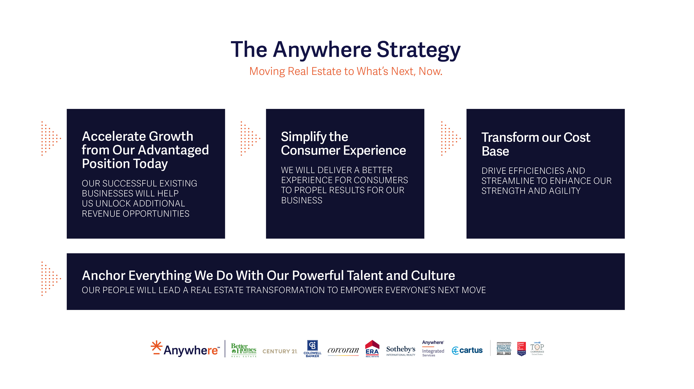

Slide 10
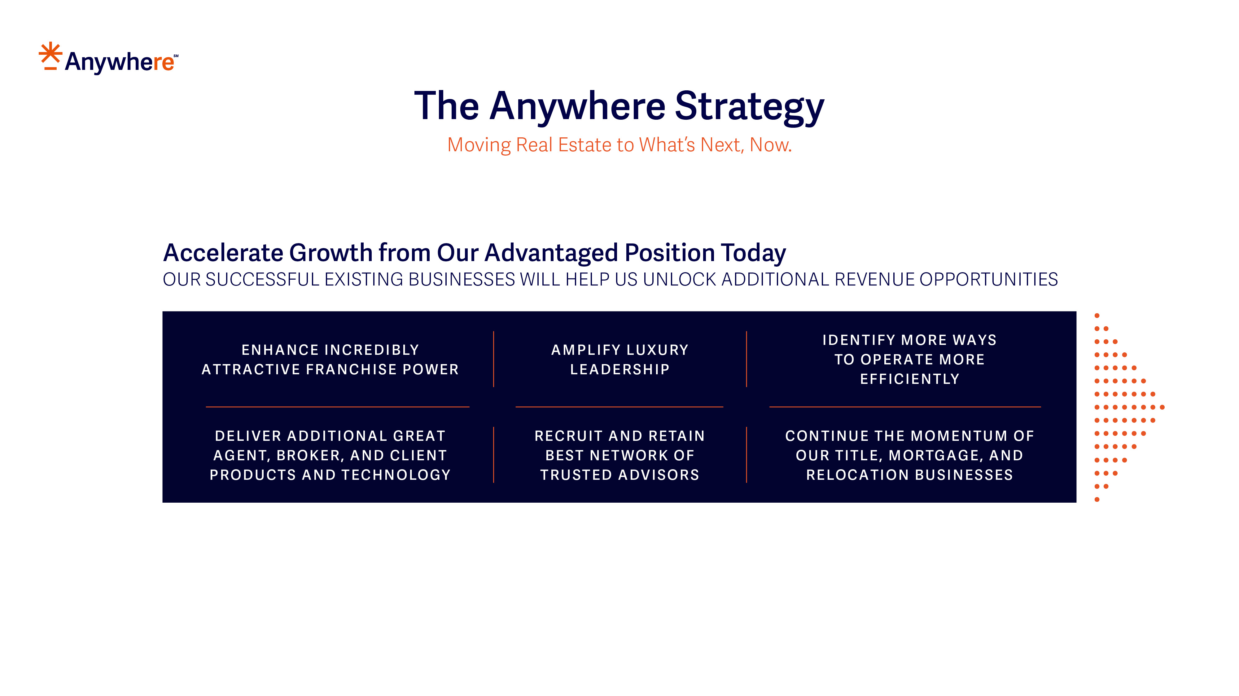

Slide 11
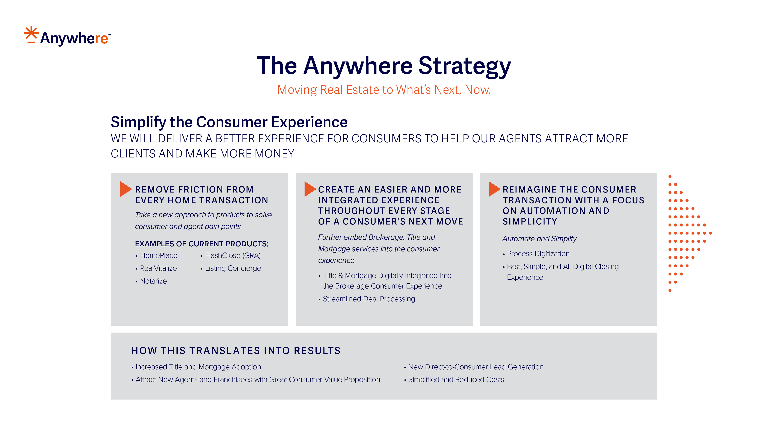

Slide 12
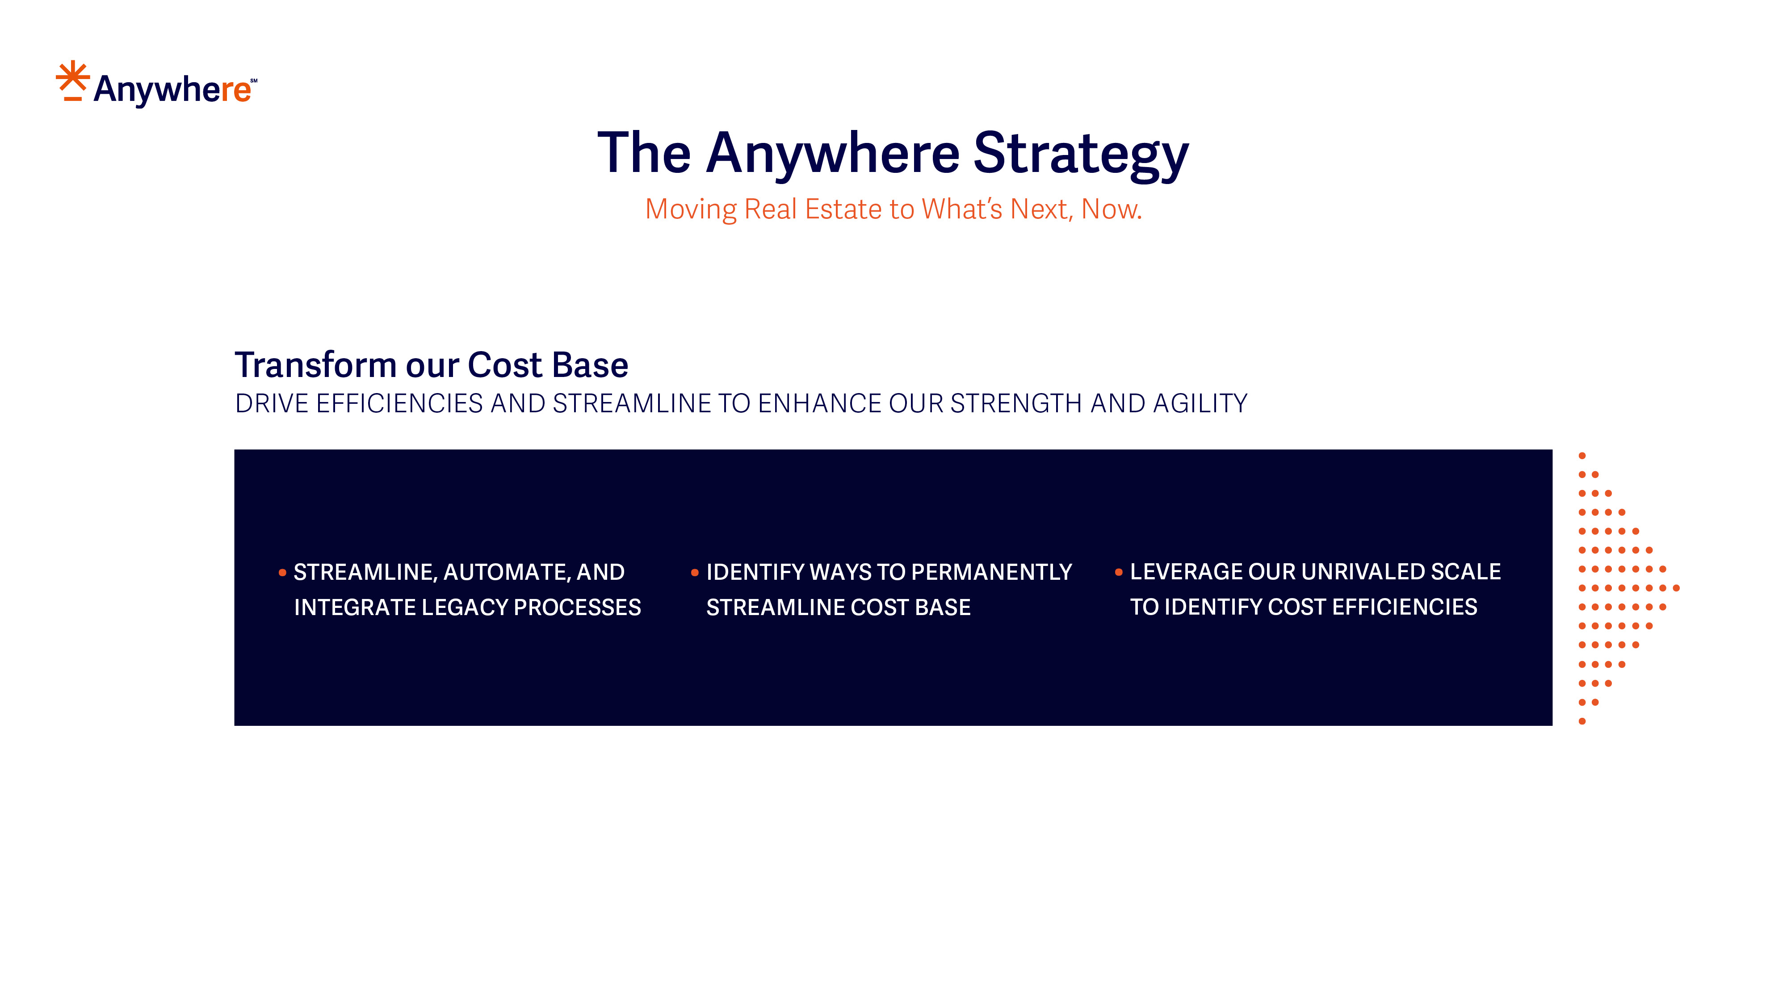

Slide 13
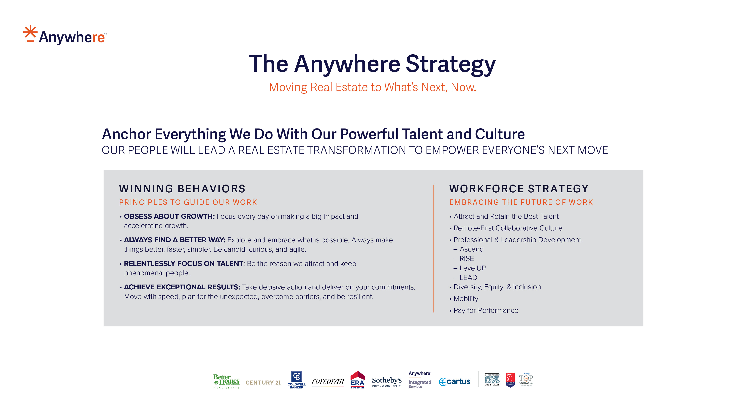

Slide 14
Leadership & History

Slide 15
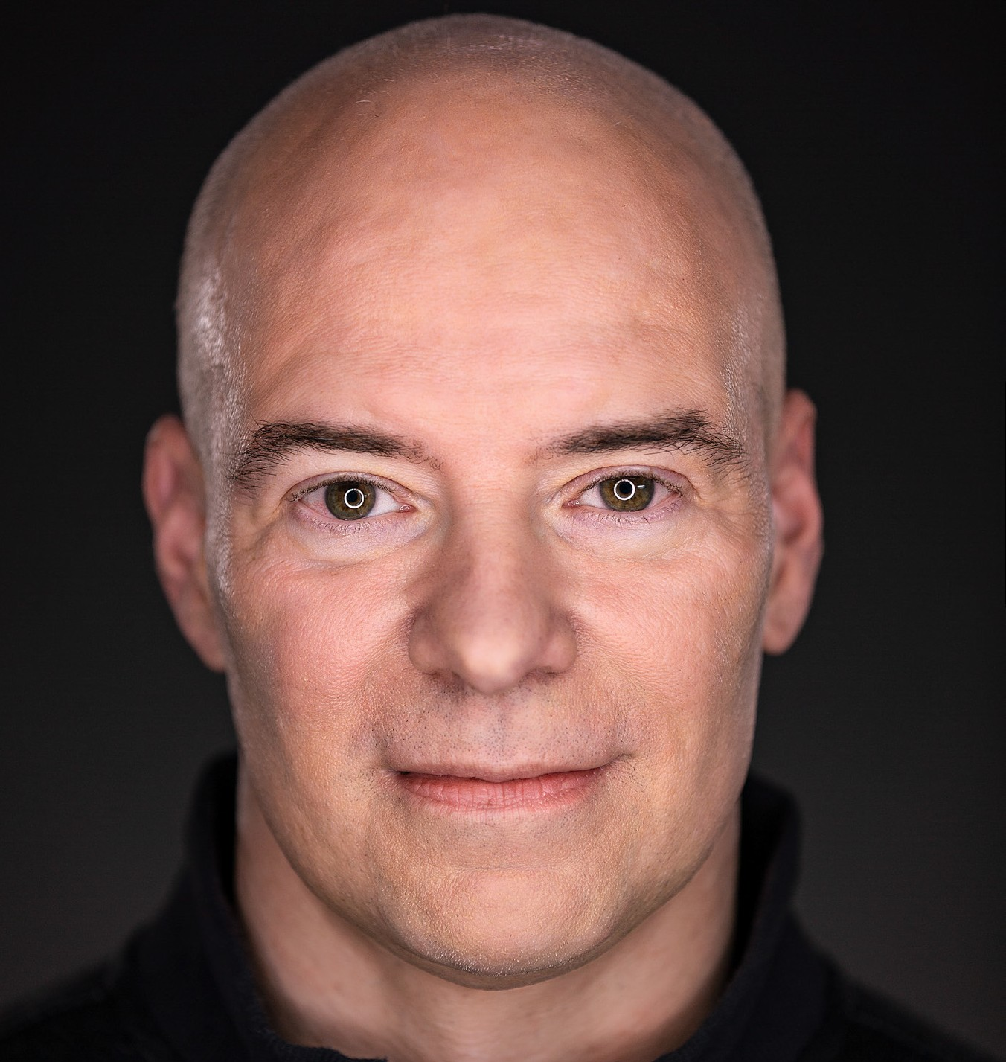
Leadership
Ryan Schneider became Chief Executive Officer effective December 31, 2017. He joined the Company as President and Chief Operating Officer in October 2017 after nearly 15 years of senior leadership experience at Capital One Financial Corporation.
He is also a member of the Anywhere Board of Directors.
Ryan Schneider
Chief Executive Officer and President

Slide 16
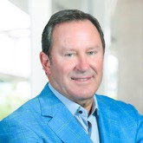

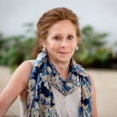
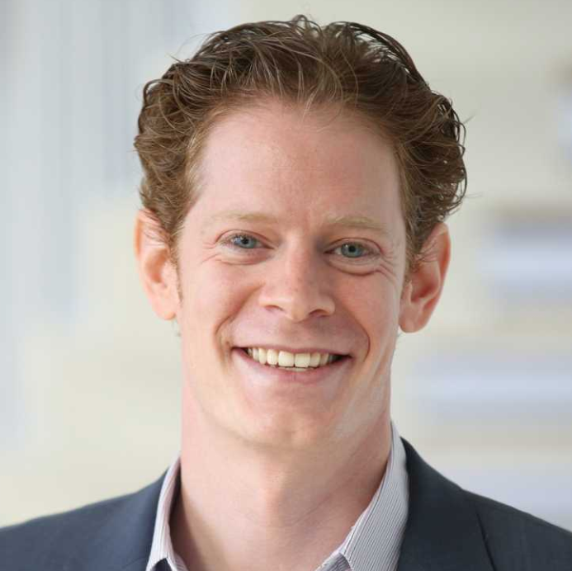
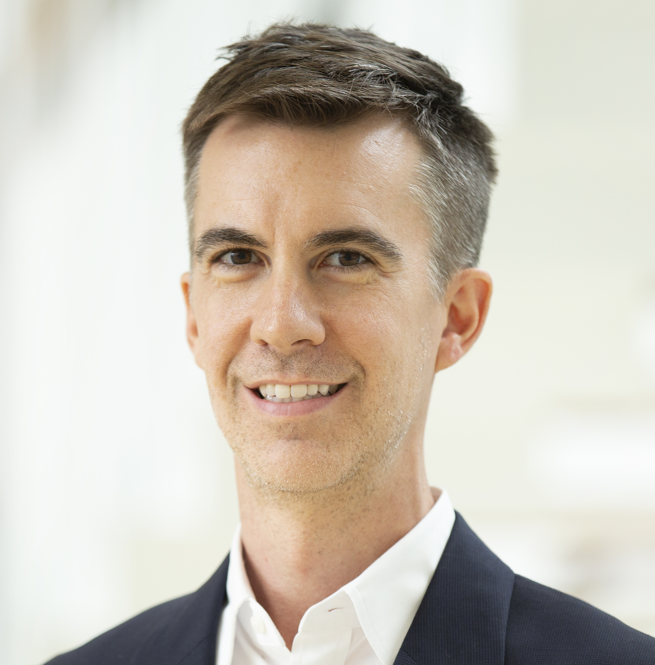
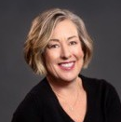
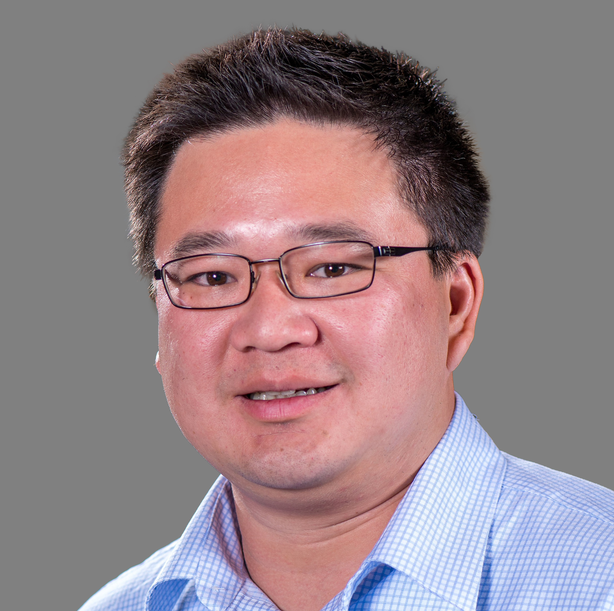
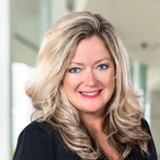
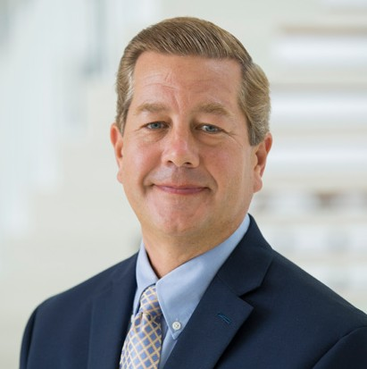
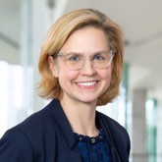
LEADERSHIP & HISTORY
Anywhere Executive Management Committee
Donald J. Casey
President and Chief Executive Officer, AIS and Relocation
Tanya Reu-Narvaez
Executive Vice President
and Chief People Officer
Marilyn J. Wasser
Executive Vice President and General Counsel
Eric Chesin
Chief Strategy Officer
Trey Sarten
Chief Communications Officer and Head of Public Affairs
Susan Yannaccone
President and Chief Executive Officer, Anywhere Brands
Tony Kueh
Executive Vice President and Chief Product Officer
Charlotte Simonelli
Executive Vice President and Chief Financial Officer
Tim Gustavson
Senior Vice President, Chief Accounting Officer and Controller
Melissa McSherry
Executive Vice President and Chief Operating Officer

Slide 17
LEADERSHIP & HISTORY
Anywhere Timeline
1995
HFS Incorporated (HFS), a predecessor company to Realogy, acquires Century 21 real estate brokerage franchise system
1997
HFS and CUC International Inc merge to create Cendant Corporation and NRT is formed by Cendant and Apollo Management
2004
Cendant enters into long-term license agreement for Sotheby’s International Realty
2007
Realogy enters into long-term license agreement for BHGRE Real Estate
2018
Ryan Schneider becomes CEO
2021
Addition of the Realogy Leads Group
1996
HFS acquires ERA and Coldwell Banker
2001
Cendant acquires The Corcoran Group
2006
Realogy becomes a stand-alone
company upon spin- off from Cendant
2012
Realogy goes public and first named one of the World’s Most Ethical Companies
2020
NRT becomes Realogy Brokerage Group, Title Resource Group becomes Realogy Title Group
2022
Realogy transforms to Anywhere
Cendant Settlement Services becomes Title Resource Group

Slide 18
Anywhere Culture & Recognition

Slide 19

CULTURE & RECOGNITION
Diversity Commitment
As one of the largest players in real estate, Anywhere has a
responsibility to help communities and individuals achieve their dreams, whether through homeownership, entrepreneurship, or employment opportunities for developing a career.
BOARD OF DIRECTORS¹
E XECUTIVE MANAGEMENT COMMITTEE¹
27%
17%
PEOPLE OF COLOR
PEOPLE OF COLOR
36%
50%
Anywhere proudly supports the:
EQUALITY ACT
FAIR HOUSING PLEDGE
CEO ACTION FOR DIVERSITY & INCLUSION
WOMEN
WOMEN
1 Numbers as of 12/31/22

Slide 20






CORPORATE SOCIAL RESPONSIBILITY
We Continue to Expand And Enhance Across Six Key Focus Areas Including
Read the Anywhere 2022 CSR Report and environmental, social, and corporate governance (ESG) initiatives here.
INTEGRITY
Infusing ethics in all we do
In 2022: honored for the 11th consecutive year as one of The World’s Most Ethical Companies.®
CULTURE
Empower everyone’s next move
In 2022: Along with our transformation, launched a new company purpose, inspirations and Winning Behaviors to help guide employees in their work every day.
DIVERSITY
Opening doors to homeownership, entrepreneurship, and career paths in real estate
In 2022: Anywhere created the DEI Advisory Board comprised of senior leaders across the business whose role is to both inform and advocate for DEI initiatives across the company and industry.
SEP 2021-SEP 2022 USA
WELLNESS
Meeting the needs of our employees, whatever they may be
In 2022: Anywhere was selected as one of four companies by Cigna with a Gold Level Healthy Workforce Designation for demonstrating a strong commitment to improving the health and well-being of our employees.
COMMUNITY
Using our reach to make lasting positive change
In 2022: Anywhere Gives opened the Anywhere Disaster Relief Fund to help colleagues and affiliated partners who were tragically impacted by Hurricane Ian. As of November 2022, over $130 thousand has been raised helping nearly 35 participants.
ENVIRONMENT
Mitigating impact on the world around us
In 2022: Opened the newly redesigned “Madison Hub” headquarters space with a ribbon cutting ceremony and celebration for employees with over 350 attendees.
Gives

Slide 21





CORPORATE SOCIAL RESPONSIBILITY
Diversity Programs
A comprehensive 46-week program that prepares the next generation of franchise owners for succession. Anywhere also launched Accelerate, a new leadership development program specifically for participants from the Inclusive Ownership Program.
A forum for our local companies to engage with and celebrate their diverse agents as well as attract outside agents.
Helps Latina entrepreneurs obtain their real estate license and provides hands-on experience to prepare them for success in the real estate industry.
Launched in 2020 for Coldwell Banker with a
2021 expansion to all of our brands, an industry-first program designed to invest in the sustainable success of diverse franchise owners.
Anywhere expanded What Move Her℠ with opportunities industry-wide, including all affiliated brokers and agents of our residential real estate brands. What Moves Her aims to help develop the leadership abilities of women in real estate and help them fully realize their professional goals.
The Anywhere Diversity and Inclusion
Networks are externally focused, market-based membership networks that meet regularly to engage and recruit diverse agents through events, marketing, and education.

Slide 22








CORPORATE SOCIAL RESPONSIBILITY
Anywhere focuses on a holistic approach to inclusiveness through diversity and inclusion councils in various business units across the enterprise.
Culture of Inclusion
The Anywhere Diversity and Inclusion Council was formed at
the start of the company, creating our Employee Resource Groups (ERGs) to drive diversity with the support of employee members and business lead sponsors.

Slide 23




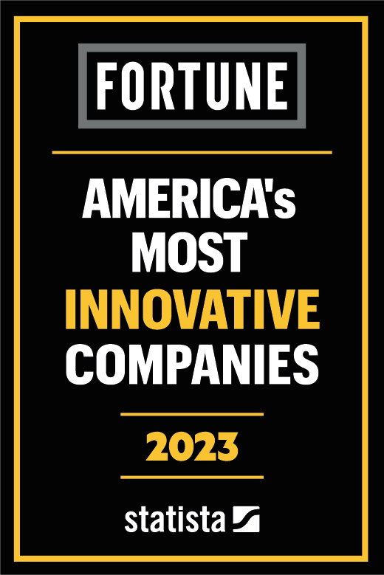






RECOGNITION & AWARDS
Recognition and Awards

Slide 24
Thank You

